Slide 1

STATE OF TEXAS v
PHILLIP NEAL

Slide 2
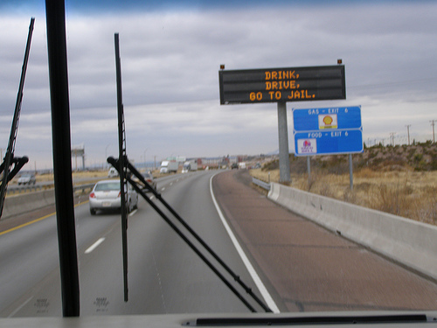
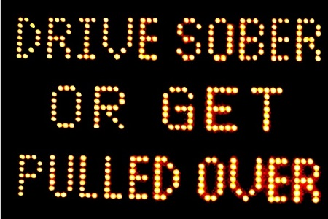
DRINKING
Drink, Drive, Go to Jail
Drive Sober or Get Pulled Over
Going Out Tonight, So Are We

Slide 3

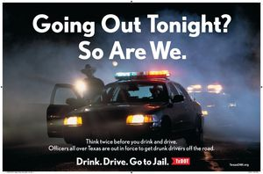

Slide 4
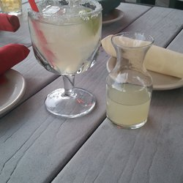
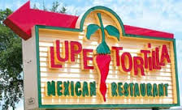
NOT ILLEGAL TO DRINK AND THEN DRIVE; as long as you’re NOT intoxicated

Slide 5
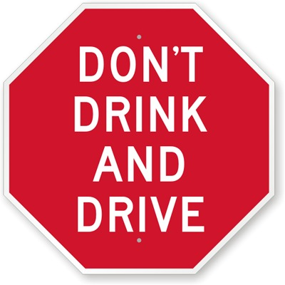
BUT WHO STILL SAYS…

Slide 6
DRINKING PATTERNS
A. REGULARLY
B. OCCASIONALLY
C. RARELY
D. NEVER
E. NOT ANY MORE

Slide 7
ALCOHOL
ALCOHOLISM IN FAMILY
NO ALCOHOL IN HOME
INJURED/VICTIM OF ALCOHOL RELATED CRIME
MEMBER OF MADD
MEMBER OF AA
STRONGLY AGREE WITH “NO REFUSAL” WEEKENDS

Slide 8


RELATED TO?

Slide 9

HOW DO YOU FEEL ABOUT POLICE LABS?
TERRIBLE GREAT

Slide 10
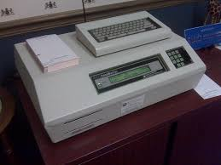
TAXALYZER 9000

Slide 11
ALCOHOL
MENTAL FACULTIES
PHYSICAL FACULTIES
MUST BE DUE TO INTOXICATION
AT THE TIME OF DRIVING

Slide 12
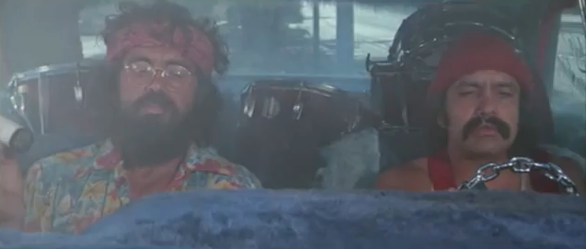
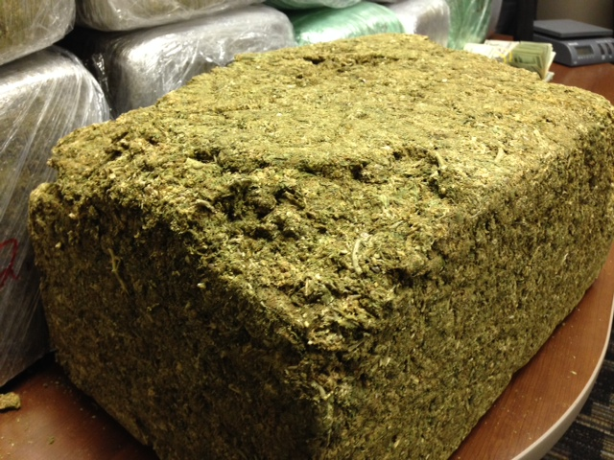

Slide 13
POSSESSION OF MARIJUANA
-In Possession At TIME OF STOP
=
DRIVING WHILE INTOXICATED
-In System AT TIME OF STOP/DRIVING

Slide 14
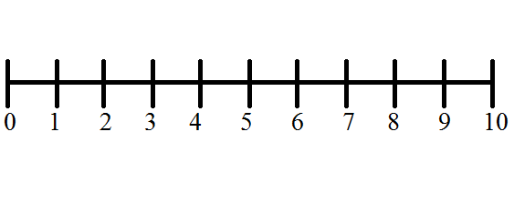
PRESUMPTION OF INNOCENCE
INNOCENT GUILTY

Slide 15
ASSUME
v.
PRESUME

Slide 16
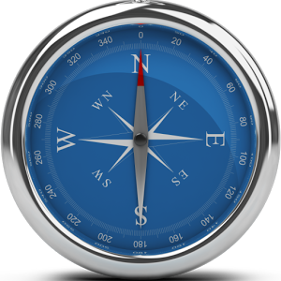

PRESUMPTION OF INNOCENCE

Slide 17
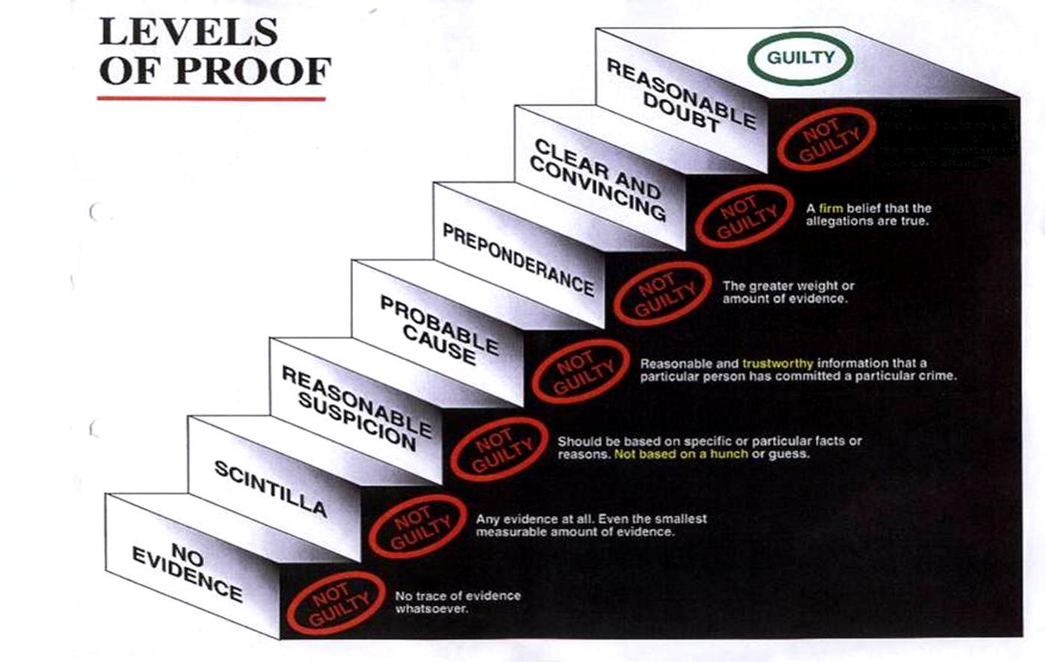

Slide 18
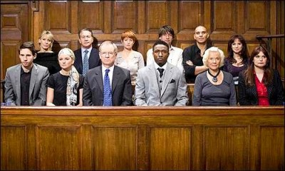
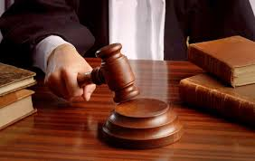
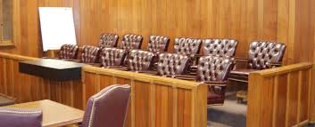
JURY SERVICE

Slide 19

THANK YOU

